Slide 1
var section = ‘Javascript’;

Slide 2
JAVASCRIPT
INTRO
Originally LiveScript developed by Netscape
Invented by Brendan Eich
Scripts not programs
Not an OOP : no class-based inheritance, no polymorphism
Not JAVA : JS is interpreted NOT compiled and loosely typed
Not HTML BUT embeddable inside HTML document
Notes:
Loosely typed – does not require variable definition i.e. same variable can be used as an integer and as a string.

Slide 3
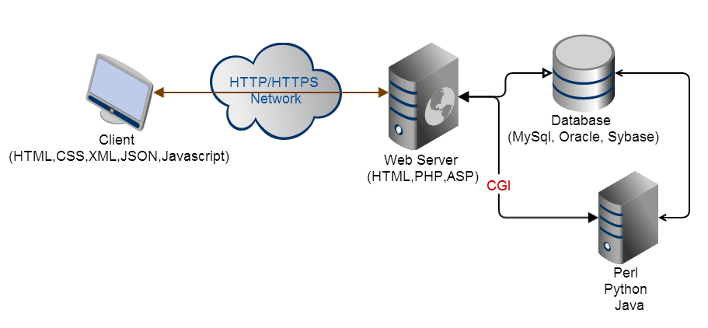
JAVASCRIPT
LIFECYCLE

Slide 4
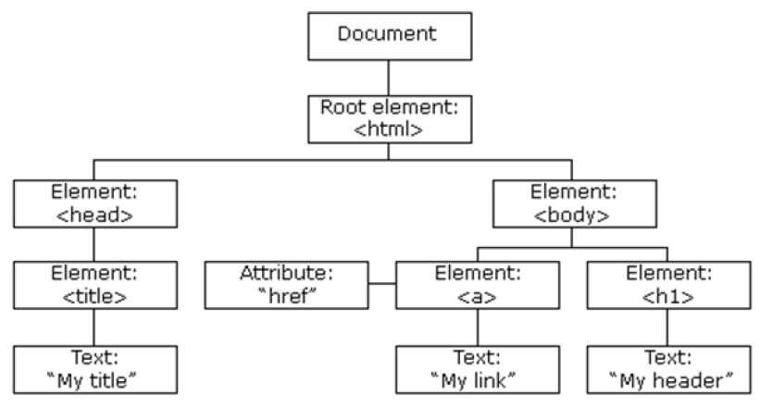
JAVASCRIPT
DOM
HTML Document Object Model (DOM) is constructed as a tree of Objects and allows dynamic HTML/CSS document manipulation.
JavaScript can access all the nodes in the tree

Slide 5
JAVASCRIPT
ADDING IT TO PAGE
Inline
<script type=“text/javascript”>
document.write(“hello”);
</script>
External File
<script type=“text/javascript” src=“myscript.js” ></script>

Slide 6
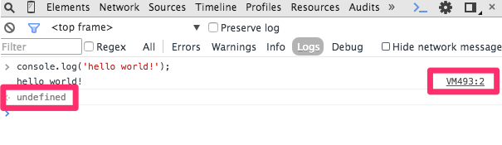
JAVASCRIPT
CONSOLE
console.log(‘hello world!’);
console.debug(‘hello world!’);
console.error(‘hello world!’);

Slide 7
JAVASCRIPT
HTML
<!DOCTYPE html>
<html>
<head>
<title>Hello World</title>
</head>
<body>
<script type="text/javascript">
document.write('hello, world!');
</script>
</body>
</html>
,

Slide 8
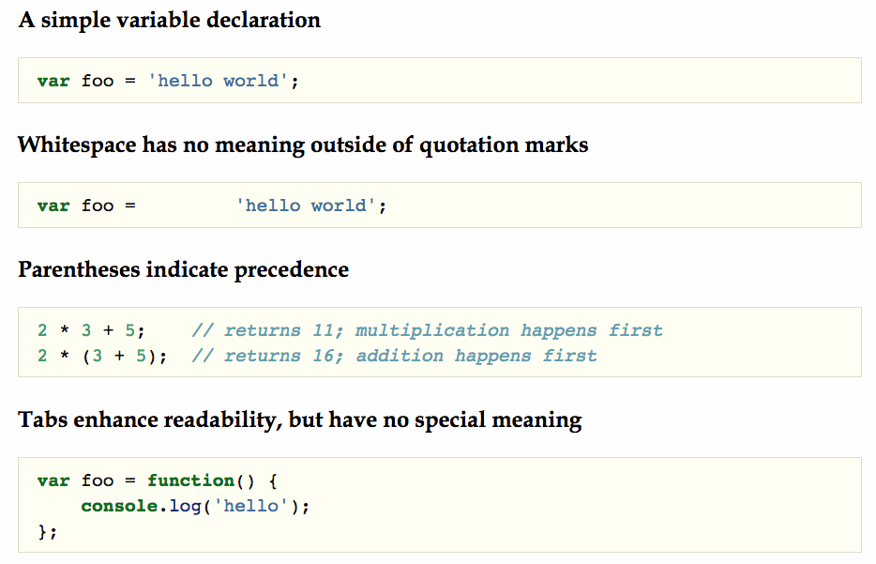
JAVASCRIPT
BASICS
,

Slide 9
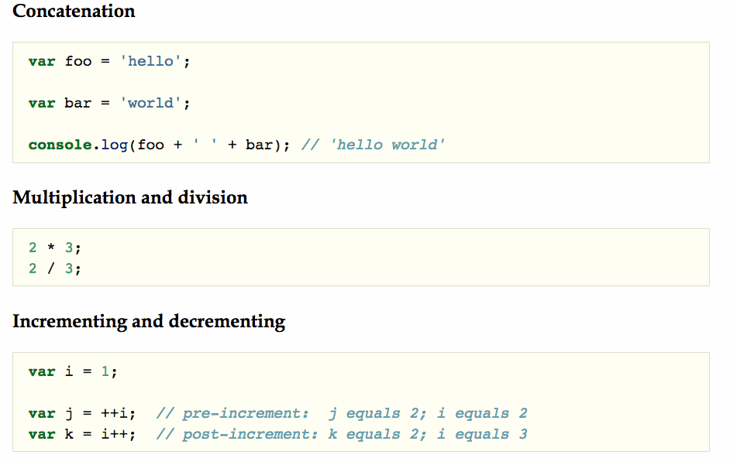
JAVASCRIPT
BASIC OPERATORS
,

Slide 10
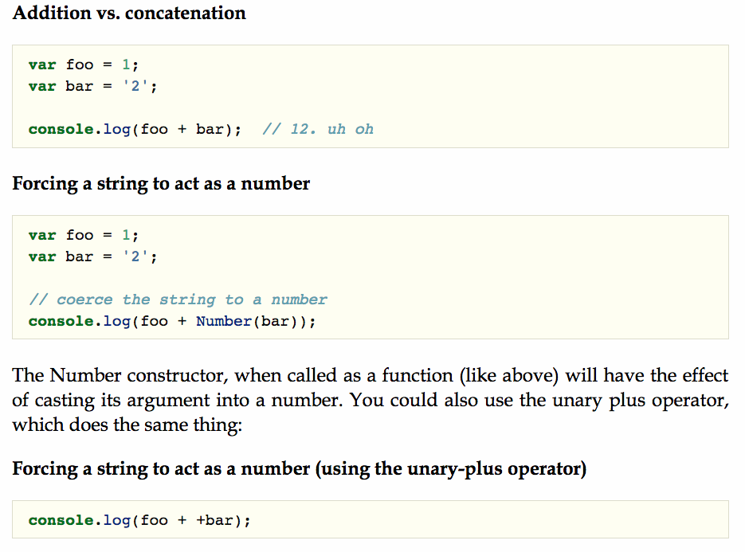
JAVASCRIPT
NUMBER & STRINGS
,

Slide 11
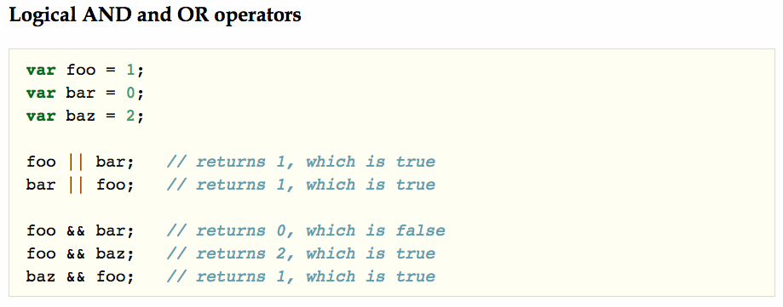
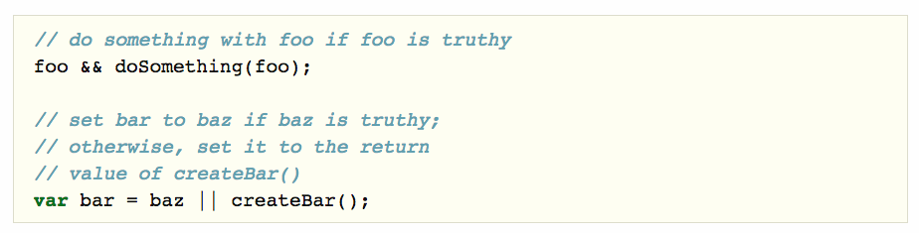
JAVASCRIPT
LOGICAL OPERATORS

Slide 12
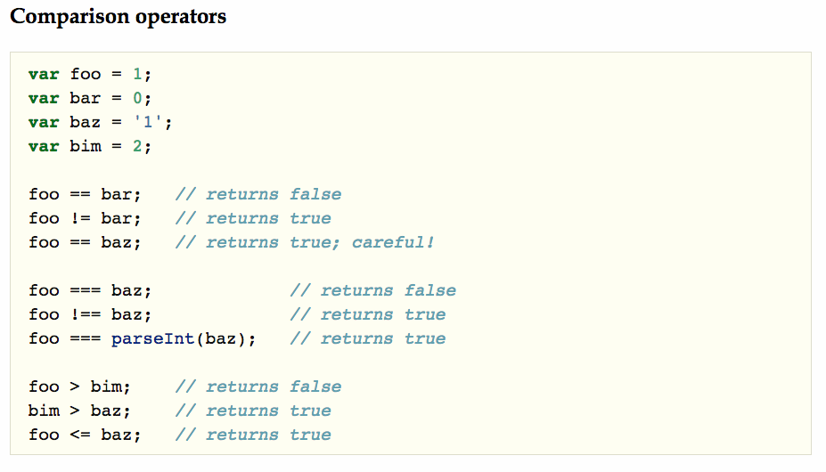
JAVASCRIPT
COMPARISON OPERATORS

Slide 13
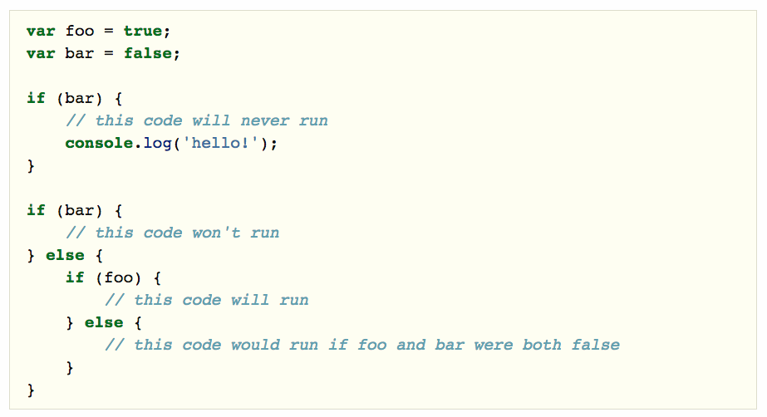
JAVASCRIPT
FLOW CONTROL

Slide 14
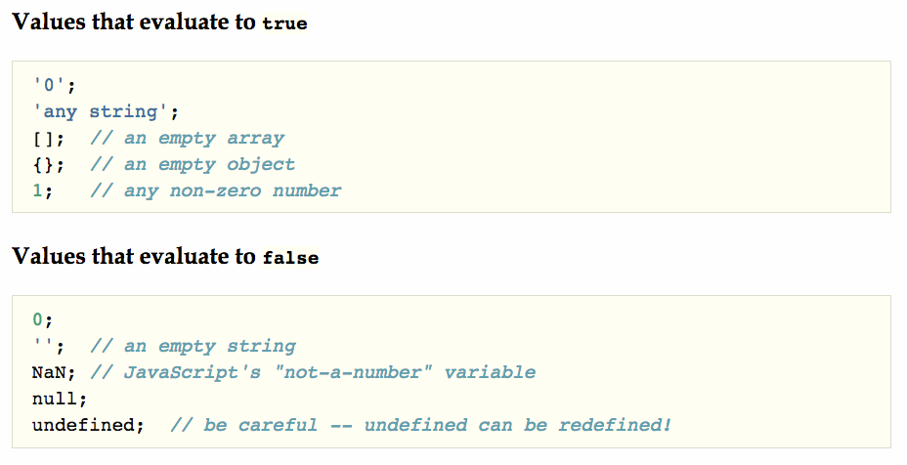
JAVASCRIPT
TRUTHY & FALSY

Slide 15
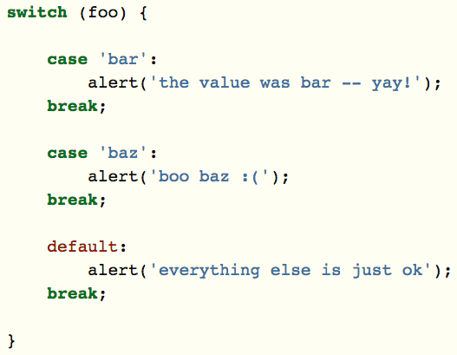
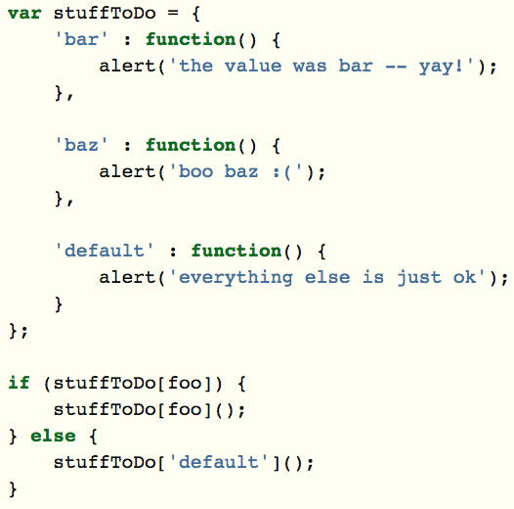
JAVASCRIPT
TRUTHY & FALSY

Slide 16
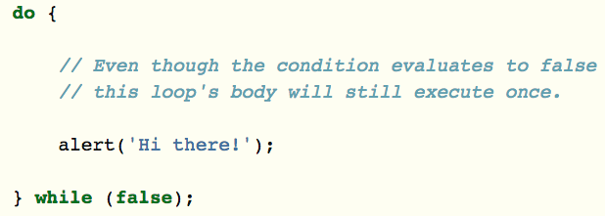
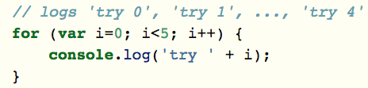
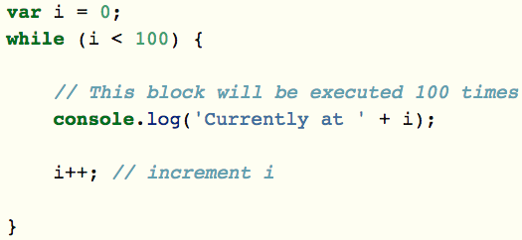
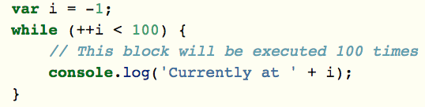
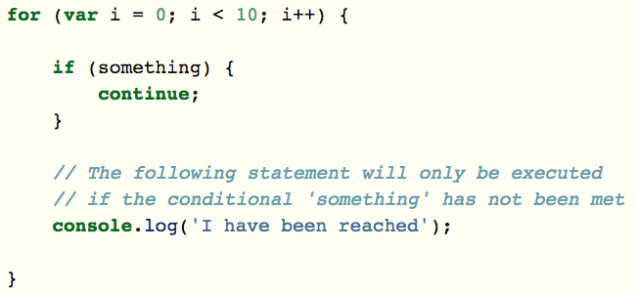
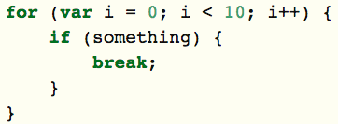
JAVASCRIPT
LOOPS

Slide 17
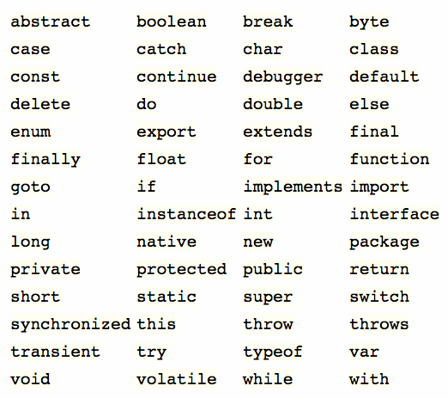
JAVASCRIPT
KEYWORDS

Slide 18
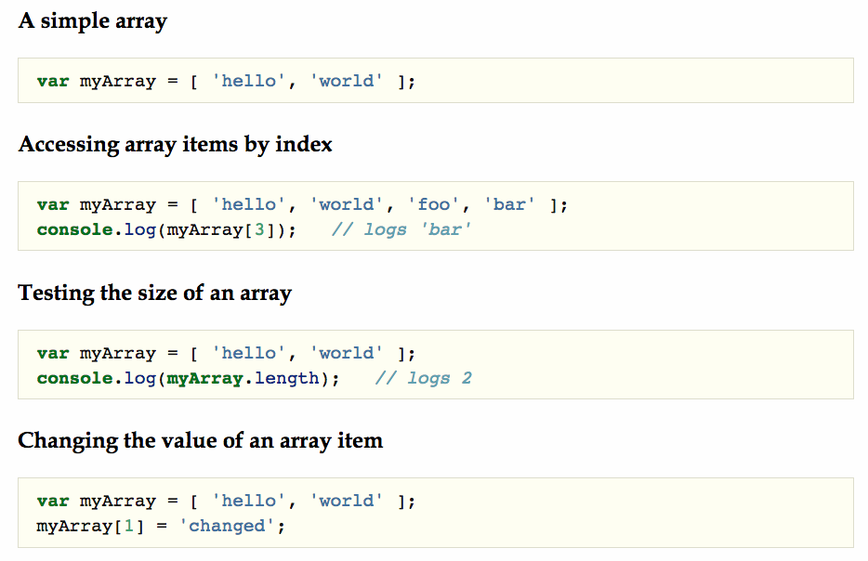
JAVASCRIPT
ARRAY - I

Slide 19
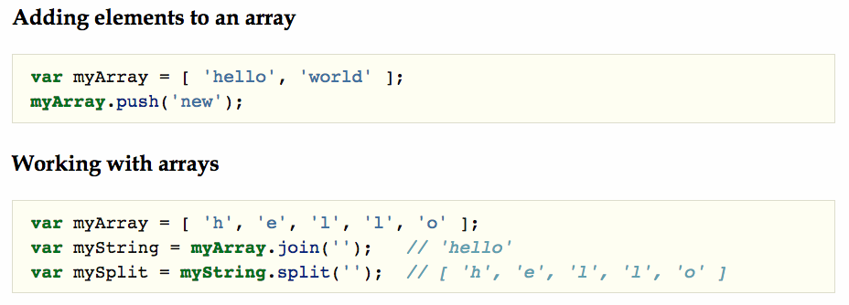
JAVASCRIPT
ARRAY - II

Slide 20
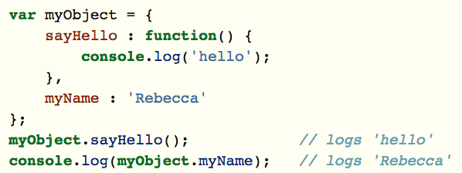
JAVASCRIPT
OBJECTS
Objects contain one or more key-value pairs. The key portion can be any string. The value portion can be any type of value: a number, a string, an array, a function, or even another object.
Everything in JavaScript is an object — arrays, functions, numbers, even strings — and they all have properties and methods.

Slide 21
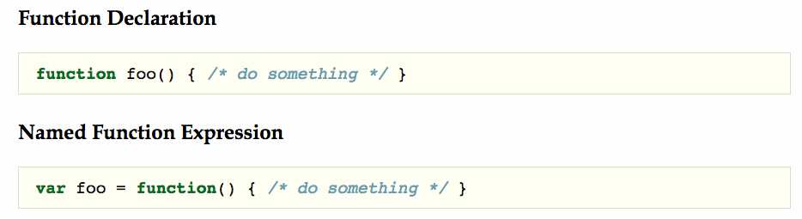
JAVASCRIPT
FUNCTIONS - I
Functions contain blocks of code that need to be executed repeatedly. Functions can take zero or more arguments, and can optionally return a value.
Named function declarations provide better debugging experience in the call stack

Slide 22
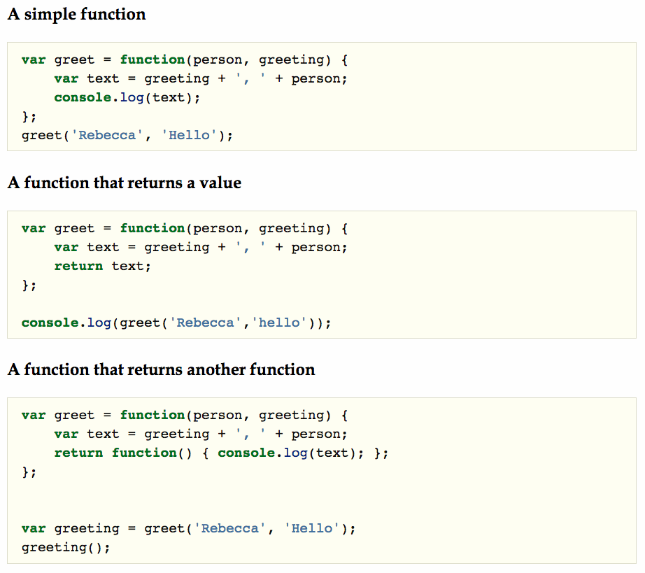
JAVASCRIPT
FUNCTIONS - II

Slide 23
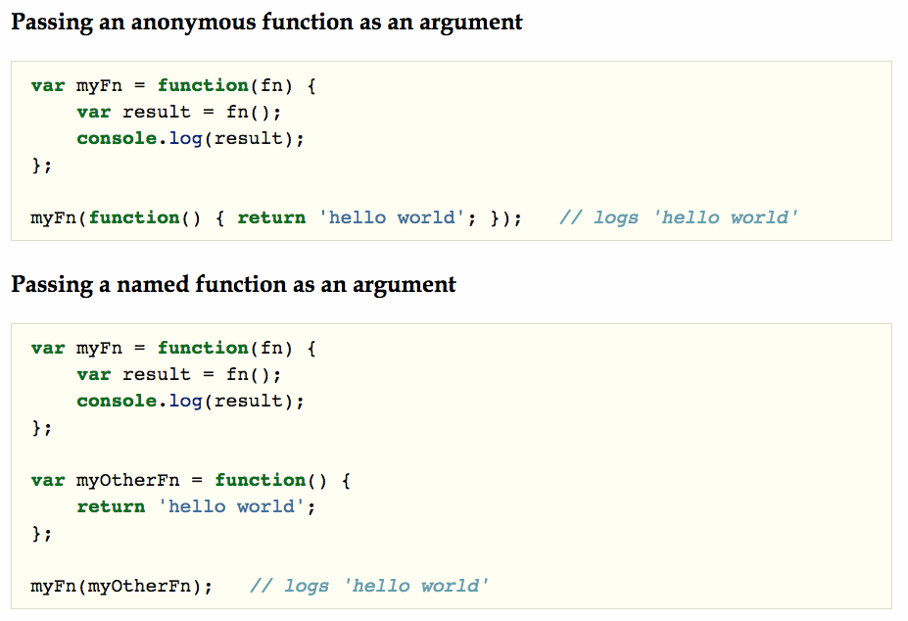
JAVASCRIPT
FUNCTIONS - III

Slide 24
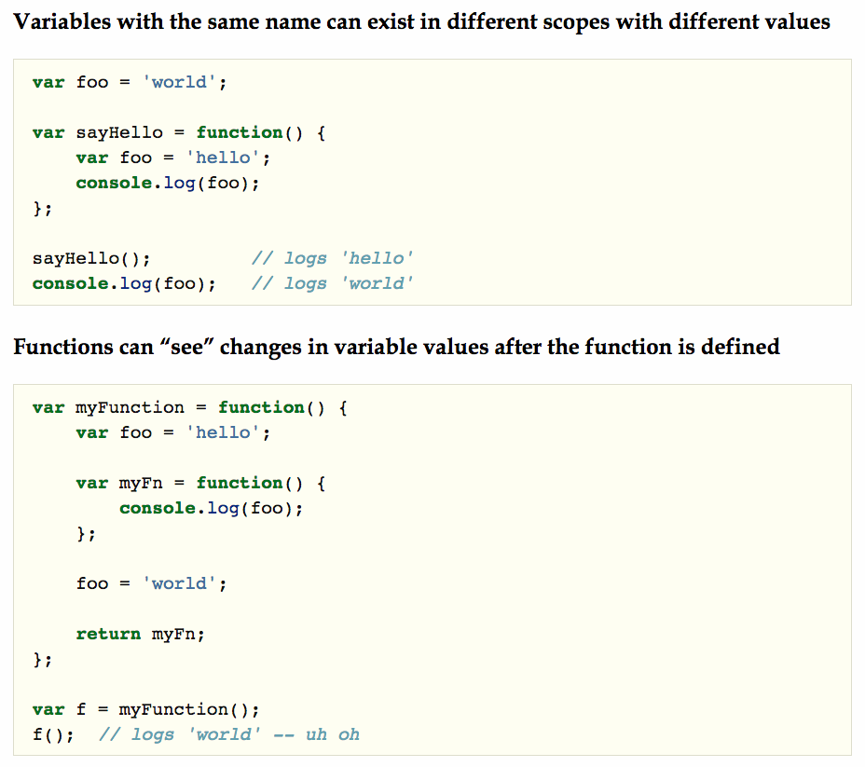
JAVASCRIPT
SCOPE
Scope refers to the variables that are available to a piece of code at a given time.

Slide 25
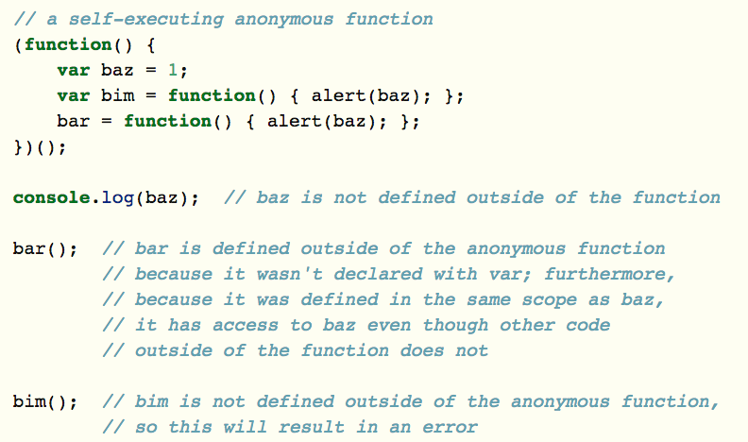
JAVASCRIPT
SCOPE
WEIRD!!

Slide 26
JAVASCRIPT
SELECTORS
querySelector & querySelectorAll
Returns the first element within the document (using depth-first pre-order traversal of the document's nodes) that matches the specified group of selectors.
getElementsByClassName & getElementById
Returns a reference to the element by its ID/Class name

Slide 27
jQuery

Slide 28
jQUERY
DOCUMENT READY
window.onload = function() {
alert( "welcome" );
};
$( document ).ready(function() {
// Your code here
});
Unfortunately, the code doesn't run until all images are finished downloading, including banner ads.
To run code as soon as the document is ready to be manipulated, jQuery has a statement known as the ready event:
<body>
<a href="http://jquery.com/">jQuery</a>
<script src=“https://ajax.googleapis.com/ajax/libs/jquery/2.1.3/jquery.min.js"></script>
<script>
$( document ).ready(function() {
$( "a" ).click(function( event ) {
alert( "The link will no longer take you to jquery.com" );
event.preventDefault();
});
});
</script>
</body>

Slide 29
jQUERY
CLASSES
$( ”#demo" ).addClass( "test" );
$( ”#demo" ).removeClass( "test" );
var d = document.getElementById(”demo”);
d.className = className + test;

Slide 30
jQUERY
AJAX
$.ajax(
{
url : '/reservations',
type: "POST",
data : postData,
success:function(data, textStatus, jqXHR)
{
//data: return data from server
},
error: function(jqXHR, textStatus, errorThrown)
{
//if fails
}
});
http://www.w3schools.com/jquery/tryit.asp?filename=tryjquery_ajax_ajax

Slide 31
Other JS frameworks

